Slide 1
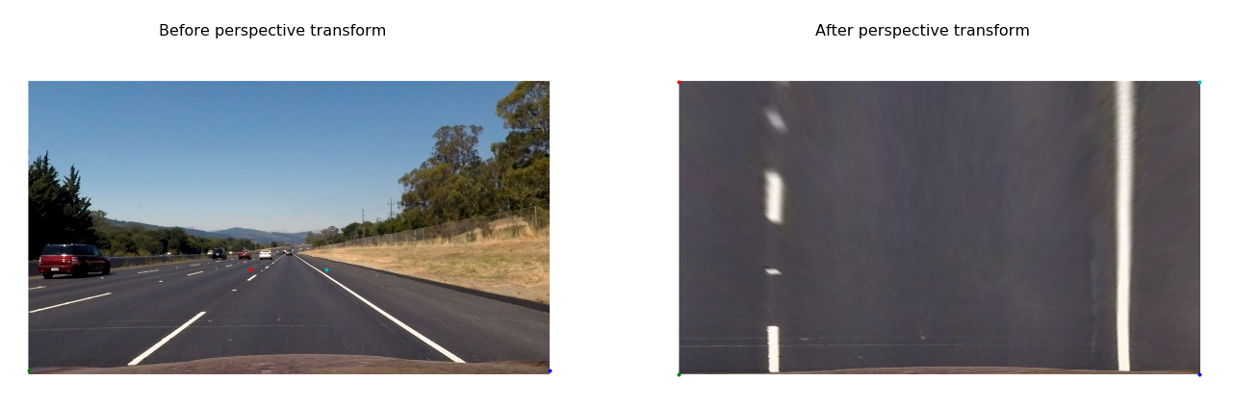
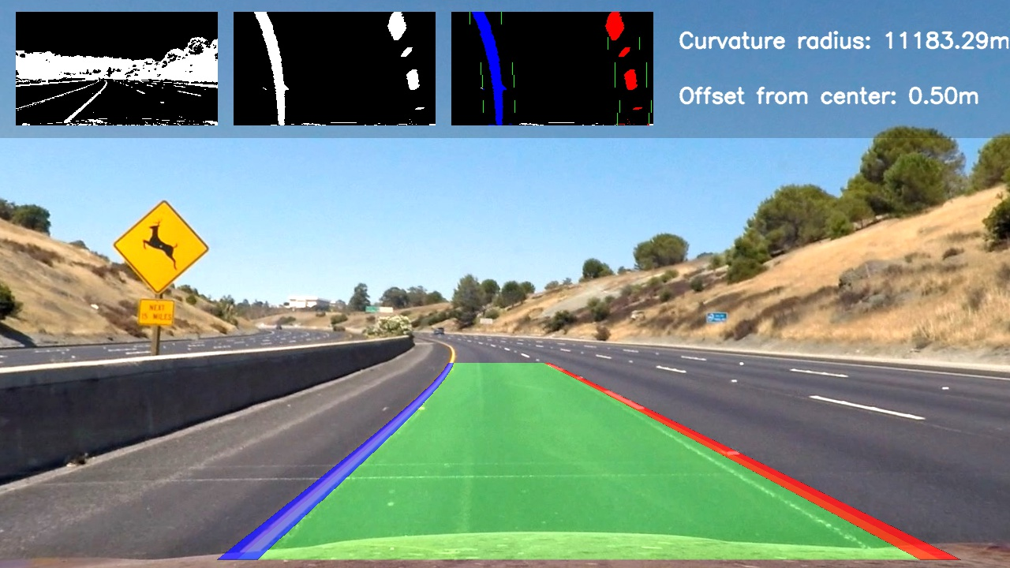
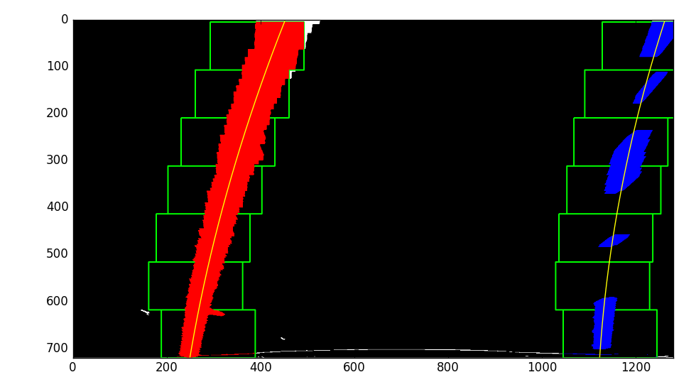
The pipeline
4. Apply a perspective transform to rectify binary image ("birds-eye view").
5. Detect lane pixels and fit to find the lane boundary.
6. Determine the curvature of the lane and vehicle position with respect to center.
7. Warp the detected lane boundaries back onto the original image.
8. Output visual display of the lane boundaries and numerical estimation of lane curvature and vehicle position.
Step 8
Step 4
Step 5-7

Slide 2
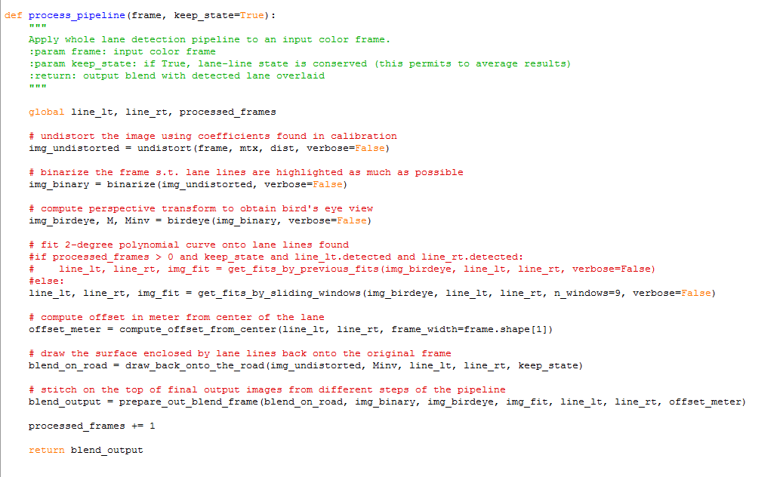
The CODE
We applied 8 steps in the pipeline

Slide 3
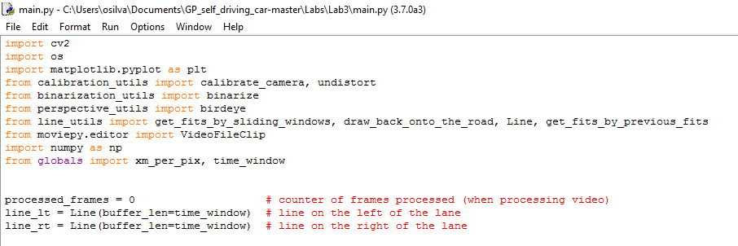
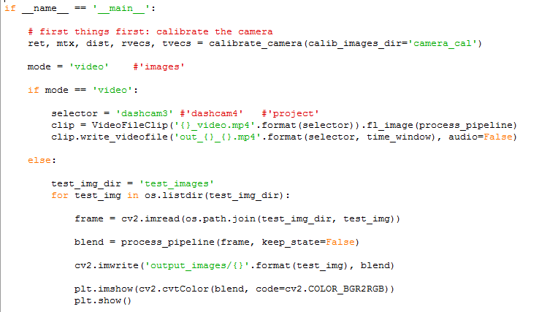
We used libraries downloaded in GitHub, then we created a tested function to the test the pipeline with various results.

